Slide 1
6. Administer Azure PaaS Compute

Slide 2




Administer PaaS Compute Options Introduction
Configure Azure App Service Plans
Configure Azure App Services
Configure Azure Container Instances
Configure Azure Kubernetes Service
Notes:
These Learn modules are part of the AZ-104: Deploy and manage Azure compute resources (https://docs.microsoft.com/learn/paths/az-104-manage-compute-resources/) learning path.

Slide 3
Configure Azure App Service Plans

Slide 4
Before Getting into App Service Plans (ASPs) ..
Web Applications need Web Servers before they can be accessed.
Linux/Windows OpenSource Web Servers: Apache Tomcat, Nginx, etc.
Nginx is beta version on Windows
Native Windows Web Server: Internet Information Services (IIS)
Multiple Web Applications can be hosted on a single webserver
There are two ways a web servers can send the request to a specific web application:
Each web application is hosted on a different port, OR
Each web application has a different host address (host header)
Notes:
App Service pricing - https://azure.microsoft.com/pricing/details/app-service/windows/

Slide 5
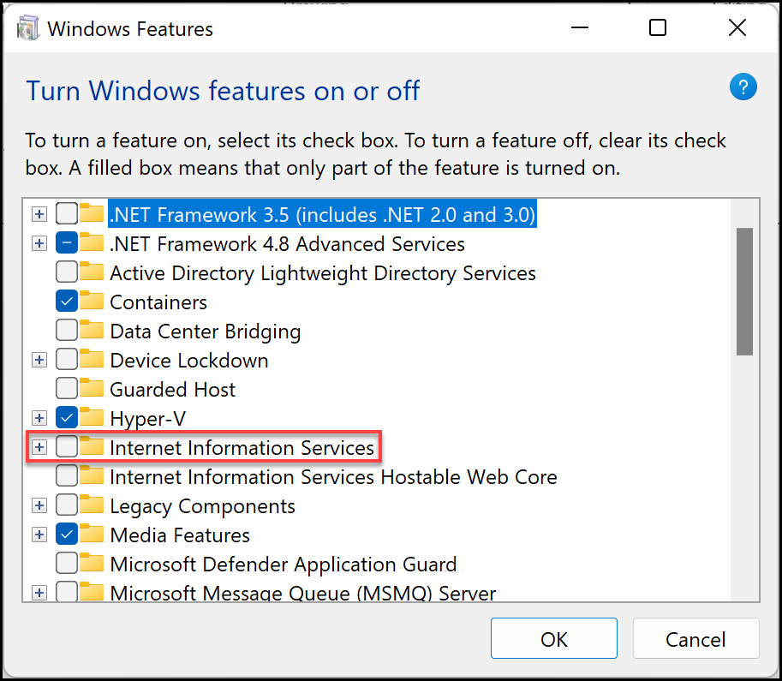
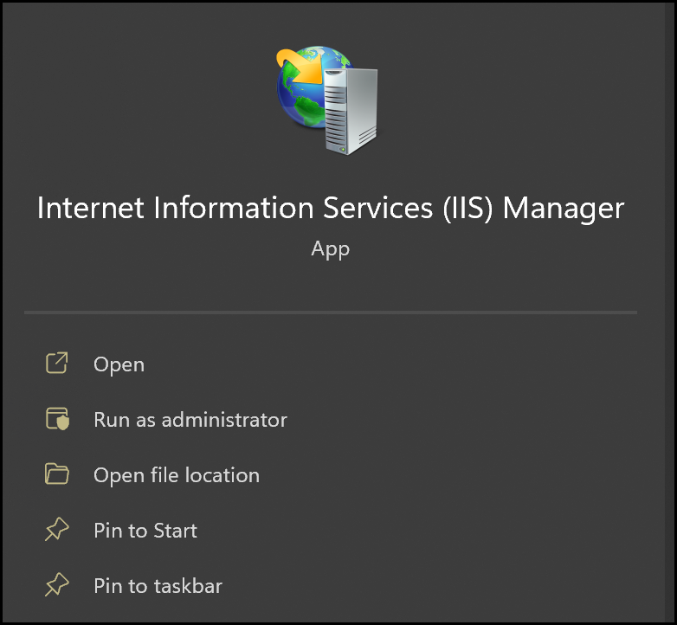
Installing IIS on Windows

Slide 6
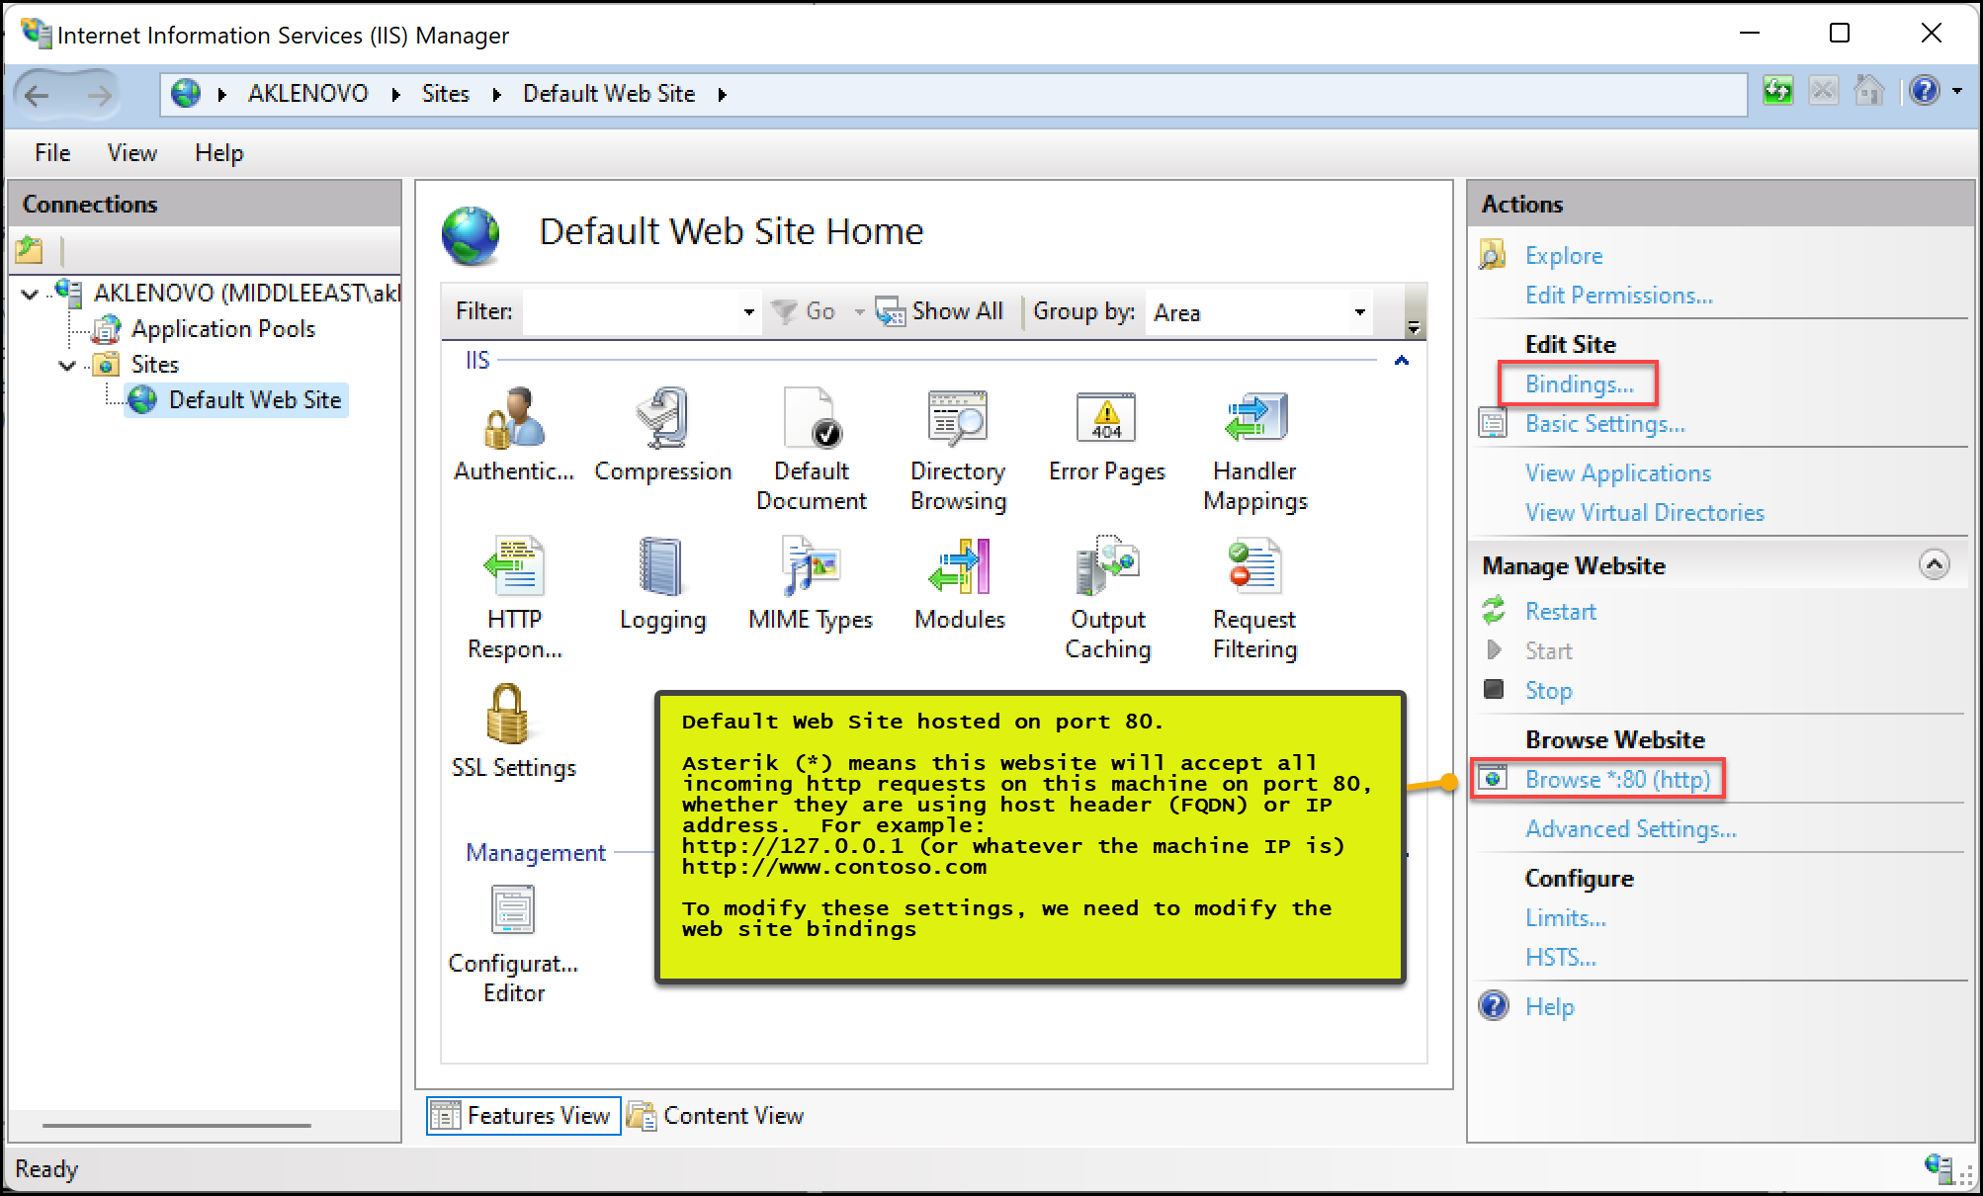

Slide 7
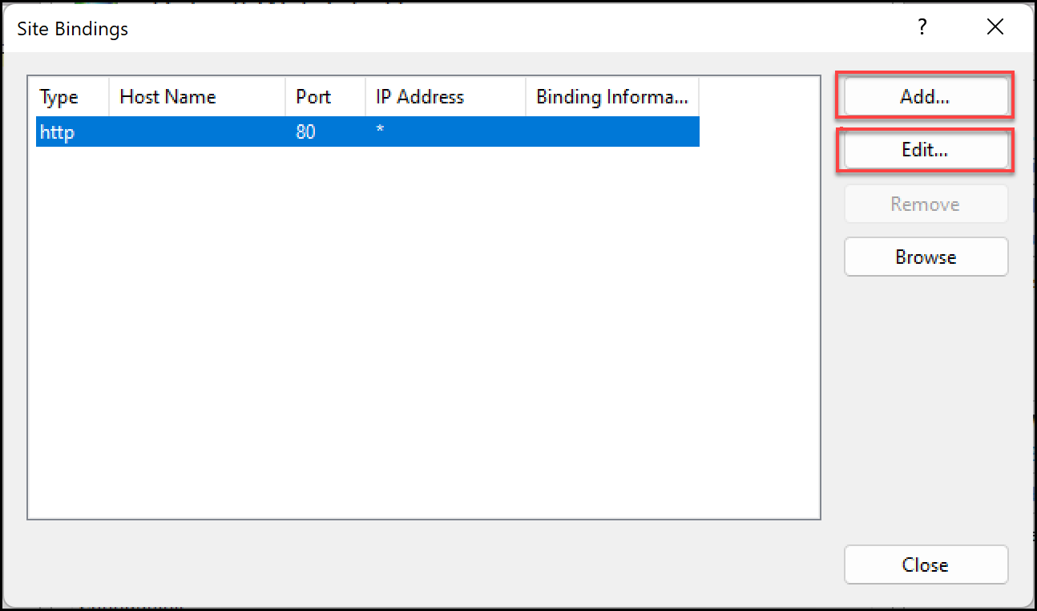
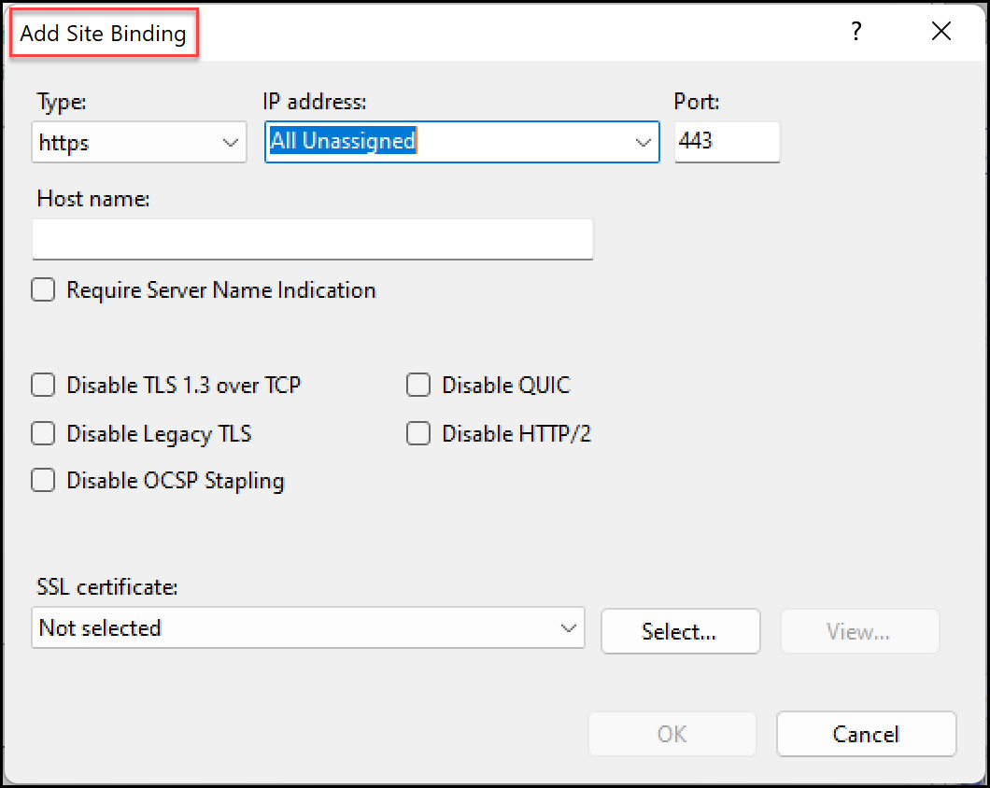
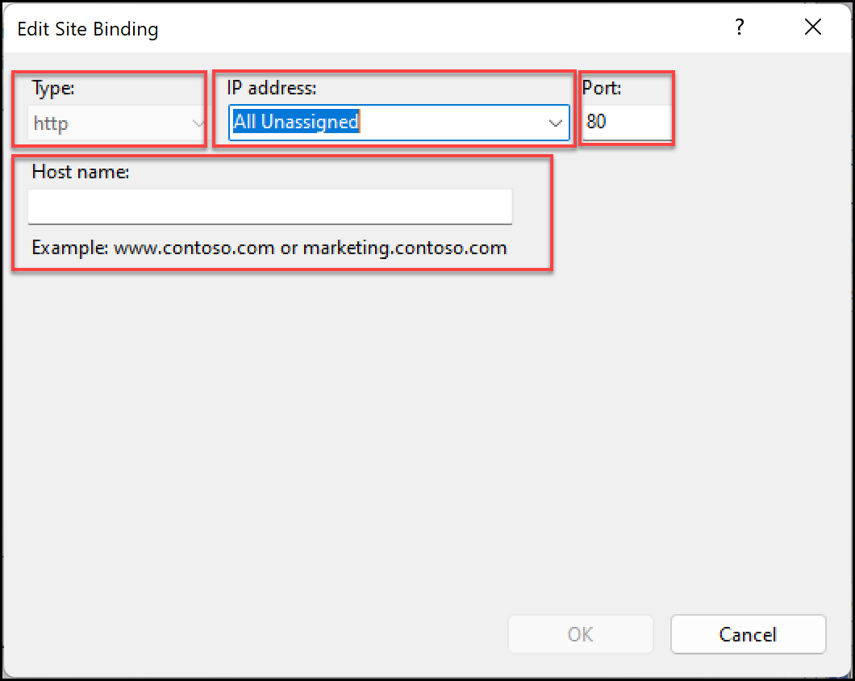
Once website is setup, add the required entries in windows hosts file (c:\windows\system32\drivers\etc\hosts) for local testing, or add a public DNS A record.
This process allows mapping of custom domain name to your website.
Notes:
How to Set Up SSL on IIS 7 or later | Microsoft Learn
How to Create and Bind a Self Signed Certificate in IIS 10 (msftwebcast.com)
What's the Hosts file
The Hosts file is used by the operating system to map human-friendly hostnames to numerical Internet Protocol (IP) addresses which identify and locate a host in an IP network. The hosts file is one of several system resources that address network nodes in a computer network and is a common part of an operating system's IP implementation. The Hosts file contains lines of text consisting of an IP address in the first text field followed by one or more host names. Each field is separated by white space (Tabs are often preferred for historical reasons, but spaces are also used). Comment lines may be included, and they are indicated by a hash character (#) in the first position of such lines. Entirely blank lines in the file are ignored.
How to reset the Hosts file back to the default - Microsoft Support

Slide 8

Configure Azure App Service Plans Introduction
Implement Azure App Service Plans
Determine App Service Plan Pricing
Scale Up and Scale Out the App Service Plan
Configure App Service Plan Scaling
Demonstration – Create an App Service Plan
Summary and Resources
Notes:
Deploy and manage Azure compute resources (20–25%)
Create and configure Azure App Service
* Create an App Service.
* Secure an App Service.
* Configure custom domain names.
* Configure backup for an App Service.
* Configure networking settings.
* Configure deployment settings.

Slide 9
Implement Azure App Service Plans
Define a set of compute resources for a web app to run
Determines performance, price, and features
One or more apps can be configured to run in the same App Service plan
Operating System (Windows, Linux)
Region where compute resources will be created
Number of virtual machine instances
Size of virtual machine instances
Pricing tier (next slide)
Notes:
Azure App Service plan overview - https://docs.microsoft.com/azure/app-service/overview-hosting-plans

Slide 10
Determine App Service Plan Pricing
Selected Features | Free | Shared (dev/test) | Basic (dedicated dev/test) | Standard (production workloads) | Premium (enhanced scale and performance) | Isolated (high-performance, security and isolation)
Web, mobile, or API apps | 10 | 100 | Unlimited | Unlimited | Unlimited | Unlimited
Disk space | 1 GB | 1 GB | 10 GB | 50 GB | 250 GB | 1 TB
Auto Scale | – | – | – | Supported | Supported | Supported
Deployment Slots | 0 | 0 | 0 | 5 | 20 | 20
Max Instances | – | – | Up to 3 | Up to 10 | Up to 30 | Up to 100
Shared compute (Free and Shared). Run apps on the same Azure VM as other App Service apps, and the resources cannot scale out
Dedicated compute (Basic, Standard, Premium). Run apps in the same plan in dedicated Azure VMs
Isolated. Runs apps on dedicated Azure VMs in dedicated Azure virtual networks
Notes:
App Service pricing - https://azure.microsoft.com/pricing/details/app-service/windows/

Slide 11
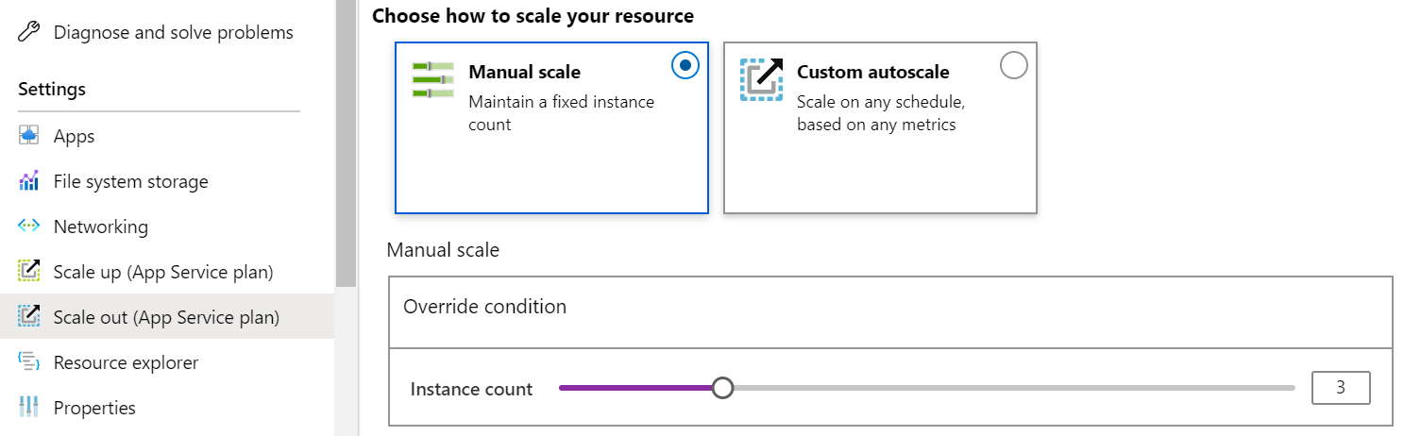
Scale Up and Scale Out the App Service Plan
Scale up (change the App Service plan):
More hardware (CPU, memory, disk)
More features (dedicated virtual machines, staging slots, autoscaling)
Scale out (increase the number of VM instances):
Manual (fixed number of instances)
Auto scale (based on predefined rules and schedules)
Notes:
Scale up an app in Azure App Service - https://docs.microsoft.com/azure/app-service/manage-scale-up

Slide 12
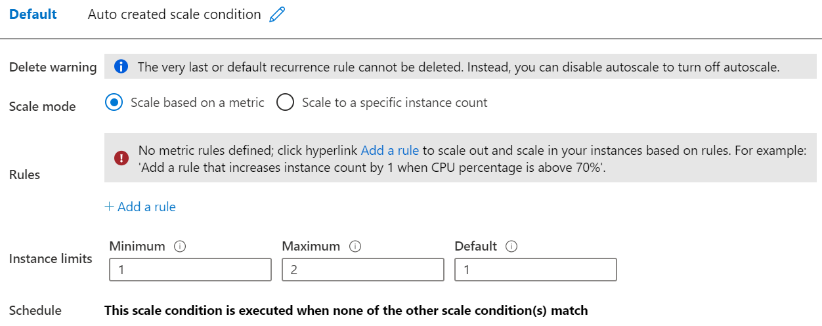
Configure App Service Plan Scaling
Adjust available resources based on the current demand
Improves availability and fault tolerance
Scale based on a metric (CPU percentage, memory percentage, HTTP requests)
Scale according to a schedule (weekdays, weekends, times, holidays)
Can implement multiple rules – combine metrics and schedules
Don’t forget to scale in
Notes:
Get started with Autoscale in Azure - https://docs.microsoft.com/azure/app-service/manage-scale-up
?toc=/azure/app-service/toc.json

Slide 13
Configure Azure App Services

Slide 14



Configure Azure App Services Introduction
Implement Azure App Service
Create an App Service
Create Deployment Slots
Add Deployment Slots
Secure an App Service
Create Custom Domain Names
Backup an App Service
Demonstration – Create an App Service
Summary and Resources
Notes:
Deploy and manage Azure compute resources (25-30%)
Create and configure Web Apps
Create and configure App Service
Create and configure App Service Plans

Slide 15
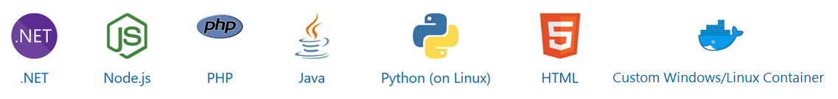
Implement Azure App Service
Includes Web Apps, API Apps, Mobile Apps, and Function Apps
Fully managed environment enabling high productivity development
Platform-as-a-service (PaaS) offering for building and deploying highly available cloud apps for web and mobile
Platform handles infrastructure so developers focus on core web apps and services
Developer productivity using .NET, .NET Core, Java, Python and a host of others
Provides enterprise-grade security and compliance
Notes:
App Service - https://azure.microsoft.com/services/app-service/

Slide 16
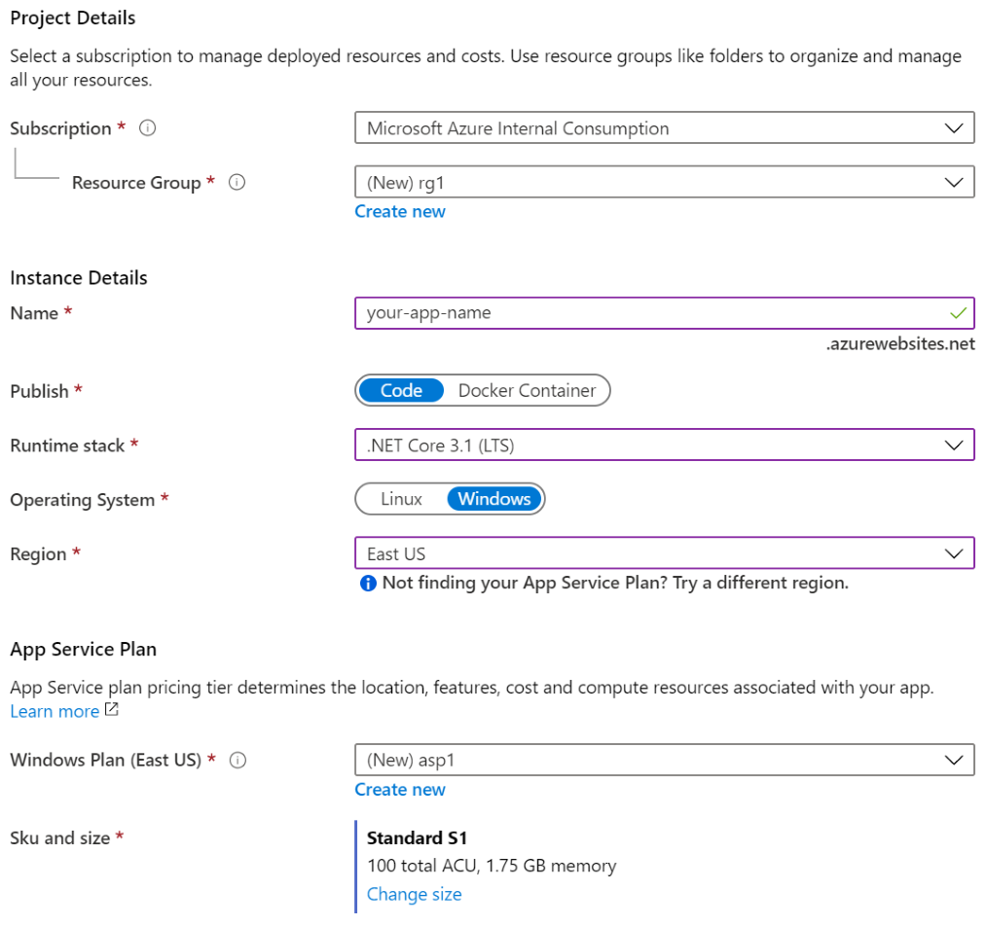
Create an App Service
Name must be unique
Access using azurewebsites.net – can map to a custom domain
Publish Code (Runtime Stack)
Publish Docker Container
Linux or Windows
Region closest to your users
App Service Plan
Notes:
Manage an App Service plan in Azure - https://docs.microsoft.com/azure/app-service/app-service-plan-manage

Slide 17



Create Deployment Slots
Service Plan | Slots
Free, Shared, Basic | 0
Standard | Up to 5
Premium | Up to 20
Isolated | Up to 20
Continuous Deployment with Stage Slot
Developer 1
GitHub
Swap
Staging
Production
Developer 2
Deploy to a different deployment slots (depends on service plan)
Validate changes before sending to production
Deployment slots are live apps with their own hostnames
Avoids a cold start – eliminates downtime
Fallback to a last known good site
Auto Swap when pre-swap validation is not needed
Notes:
Set up staging environments - https://docs.microsoft.com/azure/?toapp-service/web-sites-staged-publishingc=%2Fazure%2Fapp-service%2Ftoc.json#add-a-deployment-slot
App Service Web App – block web access to non-production deployment slots - http://ruslany.net/2014/04/azure-web-sites-block-web-access-to-non-production-deployment-slots/
✔ Each App Service plan mode supports a different number of deployment slots. To find out the number of slots your app’s mode supports, see App Service Limits.

Slide 18
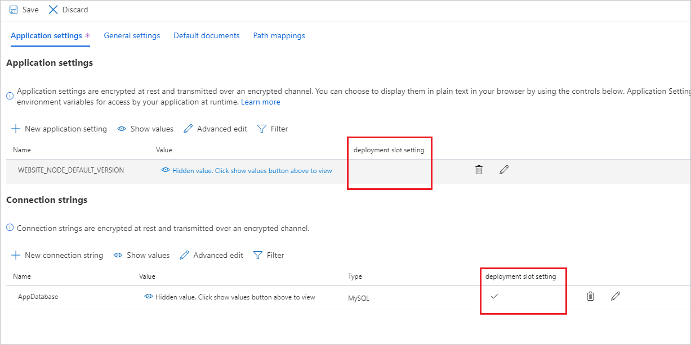
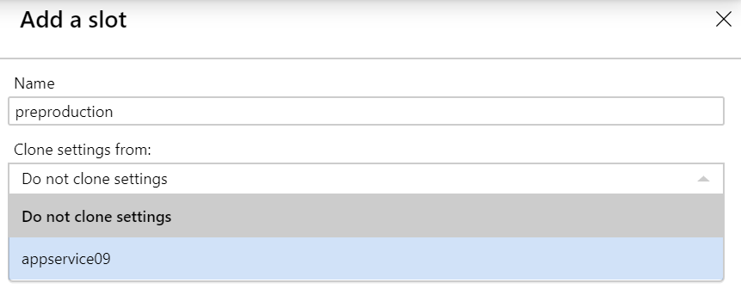
Add Deployment Slots
Select whether to clone an app configuration from another deployment slot
When you clone, pay attention to the settings:
Slot-specific app settings and connection strings
Continuous deployment settings
App Service authentication settings
Not all settings are sticky (endpoints, custom domain names, SSL certificates, scaling)
Review and edit your settings before swapping
Notes:
✔ You can configure app settings and connections to stick to a slot and not be swapped. This done in the App Settings blade. A developer can create new settings for the web app.

Slide 19
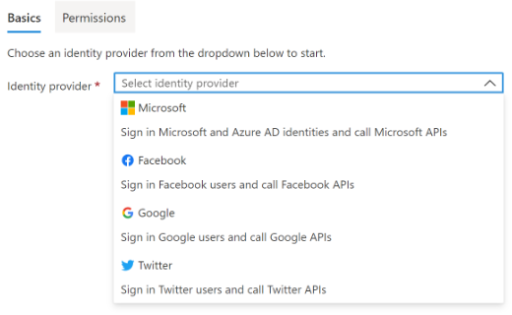
Secure an App Service
Authentication:
Enable authentication – default anonymous
Log in with a third-party identity provider
Security:
Troubleshoot with Diagnostic Logs – failed requests, app logging
Add an SSL certificate – HTTPS
Define a priority ordered allow/deny list to control network access to the app
Store secrets in the Azure Key Vault
Notes:
https://learn.microsoft.com/en-us/azure/app-service/overview-security#client-authentication-and-authorization

Slide 20
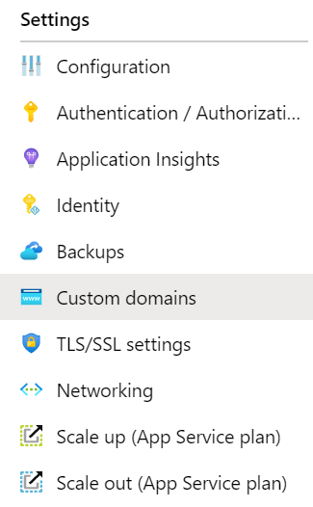
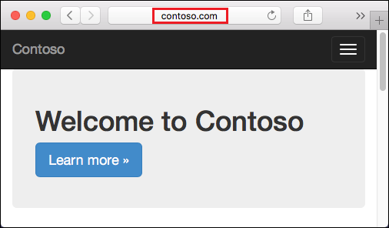
Create Custom Domain Names
Redirect the default web app URL
Validate the custom domain in Azure
Use the DNS registry for your domain provider – create a CNAME or A record with the mapping
Ensure App Service plan supports custom domains
Notes:
https://learn.microsoft.com/en-us/azure/app-service/app-service-web-tutorial-custom-domain?tabs=root%2Cazurecli#configure-a-custom-domain

Slide 21
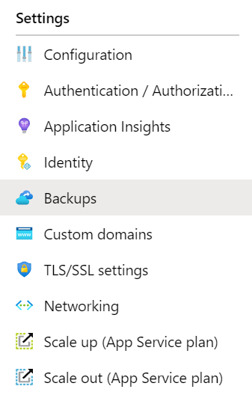
Backup an App Service
Create app backups manually or on a schedule
Backup the configuration, file content, and database connected to the app
Requires Standard or Premium plan
Backups can be up to 10 GB of app and database content
Configure partial backups and exclude items from the backup
Restore your app on-demand to a previous state, or create a new app
Notes:
Back up your App in Azure - https://docs.microsoft.com/azure/app-service/web-sites-backup
Configure partial backups - https://docs.microsoft.com/azure/app-service/web-sites-backup
https://learn.microsoft.com/en-us/azure/app-service/manage-backup?tabs=portal

Slide 22
Summary and Resources – Configure Azure App Services
Knowledge Check Questions
Microsoft Learn Modules (docs.microsoft.com/Learn)
Host a web application with Azure App Service (Sandbox)
Stage a web app deployment for testing and rollback by using App Service deployment slots
Dynamically meet changing web app performance requirements with autoscale rules
A sandbox indicates a hands-on exercise.
Notes:
List at least three administrator tasks for an organization’s web app.
If you are administering an Azure web app you will need to monitor, secure, and backup the app.
Monitoring includes usage stats, outages, page views, user sessions, performance, and troubleshooting.
Securing tasks include access, authentication, certificates, and identity.
Backup decisions make sure all parts of the app can be restored, as well as frequency of the backups.
Creating a custom domain name is another important task; there are certainly other important tasks.

Slide 23
Configure Azure Container Instances

Slide 24

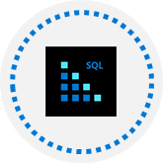
Configure Azure Container Instances Introduction
Compare Containers to Virtual Machines
Explore Azure Container Instances Benefits
Implement Container Groups
Understand the Docker Platform
Demonstration – Deploy Azure Container Instances
Summary and Resources
Notes:
Deploy and manage Azure compute resources (20–25%)
Create and configure containers
* Configure sizing and scaling for Azure Container Instances.
* Configure container groups for Azure Container Instances.

Slide 25
Compare Containers to Virtual Machines
VM
VM
Isolation
Operating System
Deployment
Persistent storage
Fault tolerance
Container
Container
App A
App B
Bins/Libs
Bins/Libs
App A
App A
App B
App B
Guest OS
Guest OS
Bins/Libs
Bins/Libs
Hypervisor
Host OS
Server
Notes:
Containers vs. virtual machines - https://docs.microsoft.com/virtualization/windowscontainers/about/containers-vs-

Slide 26
Compare Containers to Virtual Machines
Feature | Containers | Virtual Machines
Isolation | Typically provides lightweight isolation from the host and other containers but doesn’t provide as strong a security boundary as a virtual machine | Provides complete isolation from the host operating system and other VMs. This is useful when a strong security boundary is critical, such as hosting apps from competing companies on the same server or cluster
Operating system | Runs the user mode portion of an operating system and can be tailored to contain just the needed services for your app, using fewer system resources. | Runs a complete operating system including the kernel, thus requiring more system resources (CPU, memory, and storage)
Deployment | Deploy individual containers by using Docker via command line; deploy multiple containers by using an orchestrator such as Azure Kubernetes Service | Deploy individual VMs by using Windows Admin Center or Hyper-V Manager; deploy multiple VMs by using PowerShell or System Center Virtual Machine Manager
Persistent storage | Use Azure Disks for local storage for a single node, or Azure Files (SMB shares) for storage shared by multiple nodes or servers | Use a virtual hard disk (VHD) for local storage for a single VM, or an SMB file share for storage shared by multiple servers
Fault tolerance | If a cluster node fails, any containers running on it are rapidly recreated by the orchestrator on another cluster node | VMs can fail over to another server in a cluster, with the VM’s operating system restarting on the new server
Notes:
Containers vs. virtual machines - https://docs.microsoft.com/virtualization/windowscontainers/about/containers-vs-

Slide 27
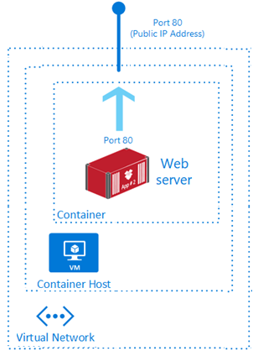
Explore Azure Container Instances Benefits
PaaS Service
Fast startup times
Public IP connectivity and DNS name
Isolation features
Custom sizes
Persistent storage
Linux and Windows Containers
Co-scheduled Groups
Virtual network Deployment
Fastest way to run a container in Azure without provisioning a VM
Notes:
What is Azure Container Instances? - https://docs.microsoft.com/azure/container-instances/container-instances-overview

Slide 28
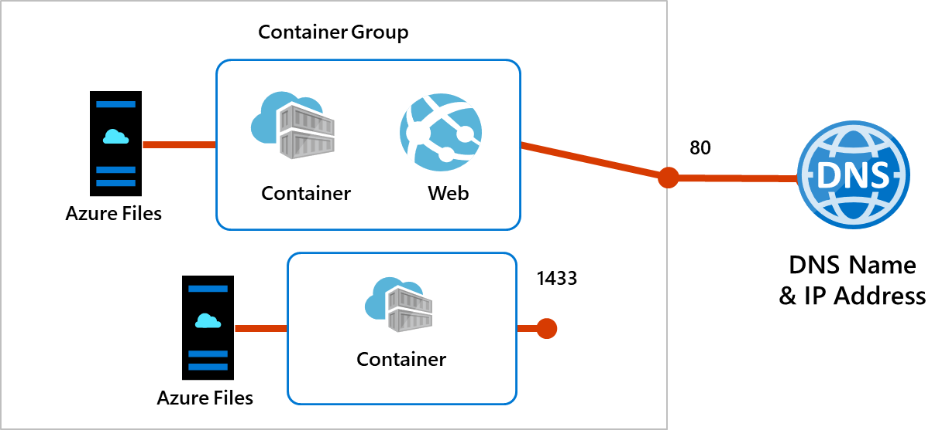
Implement Container Groups
Top-level resource in Azure Container Instances
A collection of containers that get scheduled on the same host
The containers in the group share a lifecycle, resources, local network, and storage volumes
Notes:
Quickstart: Deploy a container instance in Azure using the Azure portal - https://docs.microsoft.com/azure/container-instances/container-instances-quickstart-portal

Slide 29
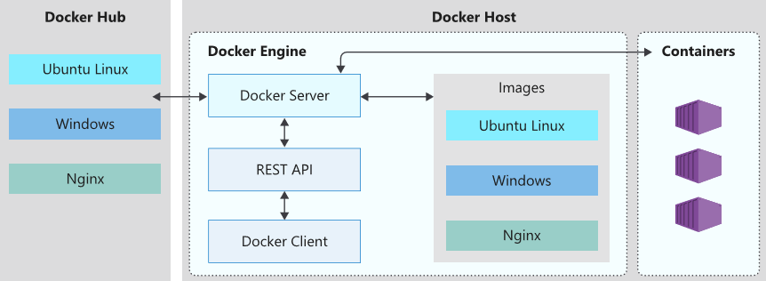
Understand the Docker Platform
Enables developers to host applications within a container
A container is a standardized “unit of software“ that contains everything required for an application to run
Available on both Linux and Windows and can be hosted on Azure
Notes:
Docker on Azure - https://azure.microsoft.com/services/kubernetes-service/docker/

Slide 30
Summary and Resources – Configure Azure Container Instances
Knowledge Check Questions
Microsoft Learn Modules (docs.microsoft.com/Learn)
Run Docker containers with Azure Container Instances
Build a containerized web application with Docker
Notes:
Describe at least two differences between containers and virtual machines.
Answer: Containers provide only lightweight isolation, whereas VMs provide complete isolation. VMs run the entire operating systems, but containers only run the OS services that are needed. Containers are deployed with Docker and orchestrated with Azure Kubernetes service. VMs are deployed and managed different tools with Azure. Containers can use local disk storage or file shares. VMs use a virtual hard disk and file shares.

Slide 31
Configure Azure Kubernetes Service

Slide 32
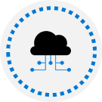

Configure Azure Kubernetes Service Introduction
Understand AKS Terminology
Understand AKS Clusters and Nodes
Configure AKS Networking
Configure AKS Storage
Configure AKS Scaling
Configure AKS Scaling to ACI (optional)
Demonstration – Deploy Azure Kubernetes Service (optional)
Summary and Resources
Notes:
Instructor – optional slides at the end of the presentation.
Deploy and manage Azure compute resources (20–25%)
Create and configure containers
* Configure storage for Azure Kubernetes Service (AKS).
* Configure scaling for AKS.
* Configure network connections for AKS.
* Upgrade an AKS cluster.

Slide 33
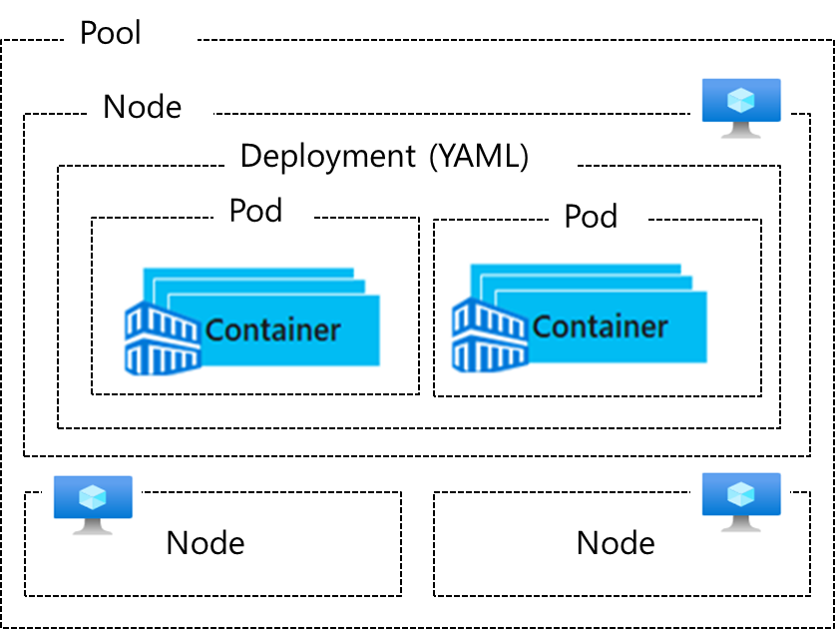
Understand AKS Terminology
Term | Description
Pools | Groups of nodes with identical configurations
Nodes | Individual VMs running containerized applications
Pods | Single instance of an application. A pod can contain multiple containers
Deployment | One or more identical pods managed by Kubernetes​
Manifest | YAML file describing a deployment
Notes:
Kubernetes core concepts for Azure Kubernetes Service (AKS) - https://docs.microsoft.com/azure/aks/concepts-clusters-workloads

Slide 34
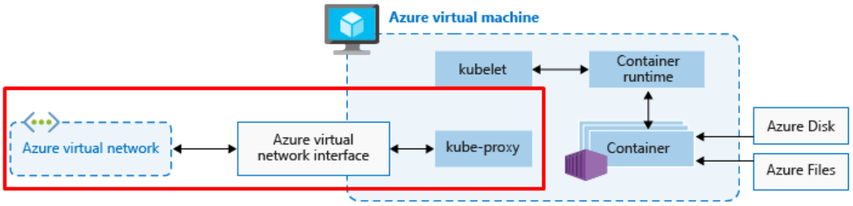
Understand AKS Clusters and Nodes
Azure-managed node provides core Kubernetes services and orchestration
Customer-managed nodes run applications and supporting services
Each individual node is an Azure virtual machine
Notes:
https://kodekloud.com/blog/kube-proxy/
https://kubernetes.io/docs/concepts/architecture/#kubelet

Slide 35
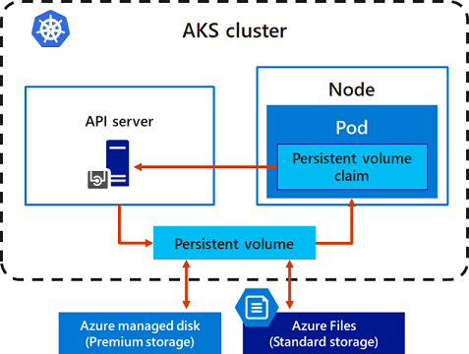
Configure AKS Storage
Local storage on the node is fast and simple to use
Local storage might not be available after the pod is deleted
Multiple pods may share data volumes
Storage could potentially be reattached to another pod
Notes:
Storage options for applications in Azure Kubernetes Service (AKS) - https://docs.microsoft.com/azure/aks/concepts-storage
Persistent Volume (PV) is a storage resource created and managed by the Kubernetes API that can exist beyond the lifetime of an individual pod.
A persistent volume claim (PVC) requests storage of a particular storage class, access mode, and size.

Slide 36
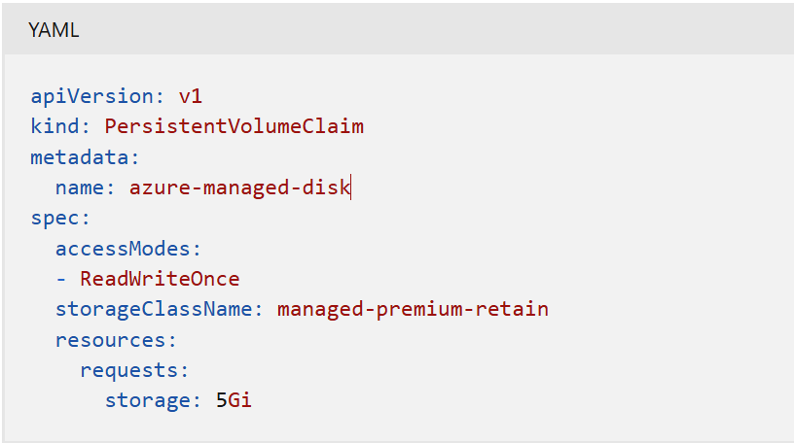
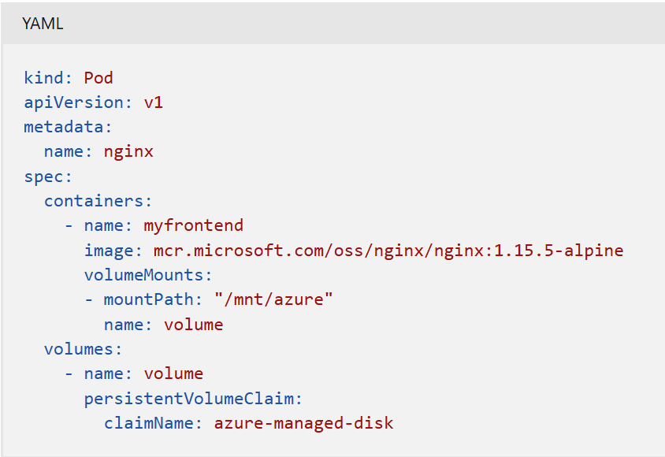
Persistent volume claim that uses the managed-premium storage class and requests an Azure Disk that is 5Gi in size:
Previously created persistent volume claim being used to mount a volume in a pod definition:

Slide 37
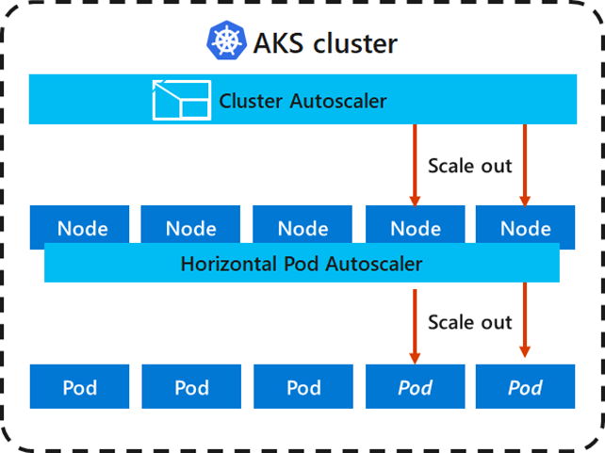
Configure AKS Scaling
Applications might grow beyond the capacity of a single pod
Kubernetes has built-in autoscalers
Cluster autoscaler scales based on compute resources
Horizontal pod autoscaler scales based on metrics
Notes:
Scaling options for applications in Azure Kubernetes Service (AKS) - https://docs.microsoft.com/azure/aks/concepts-scale
Kubernetes uses the horizontal pod autoscaler (HPA) to monitor the resource demand and automatically scale the number of pods. By default, the HPA checks the Metrics API every 15 seconds for any required changes in replica count, and the Metrics API retrieves data from the Kubelet every 60 seconds. So, the HPA is updated every 60 seconds. When changes are required, the number of replicas is increased or decreased accordingly. HPA works with AKS clusters that deployed the Metrics Server for Kubernetes version 1.8 and higher.
Cluster autoscaler
To respond to changing pod demands, the Kubernetes cluster autoscaler adjusts the number of nodes based on the requested compute resources in the node pool. By default, the cluster autoscaler checks the Metrics API server every 10 seconds for any required changes in node count. If the cluster autoscaler determines that a change is required, the number of nodes in your AKS cluster is increased or decreased accordingly.

Slide 38
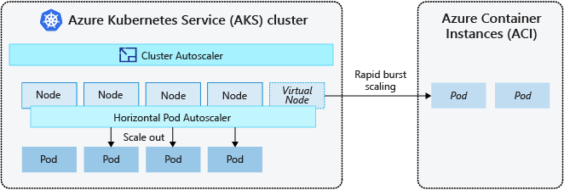
Configure AKS Scaling to ACI (optional)
If you need to rapidly grow your AKS cluster, you can create new pods in Azure Container Instances
Notes:
https://learn.microsoft.com/en-us/azure/aks/concepts-scale
Burst to Azure Container Instances (ACI)
To rapidly scale your AKS cluster, you can integrate with Azure Container Instances (ACI). Kubernetes has built-in components to scale the replica and node count.
ACI lets you quickly deploy container instances without extra infrastructure overhead. When you connect with AKS, ACI becomes a secured, logical extension of your AKS cluster. The virtual nodes component, which is based on virtual Kubelet, is installed in your AKS cluster that presents ACI as a virtual Kubernetes node. Kubernetes can then schedule pods that run as ACI instances through virtual nodes, not as pods on VM nodes directly in your AKS cluster.

Slide 39
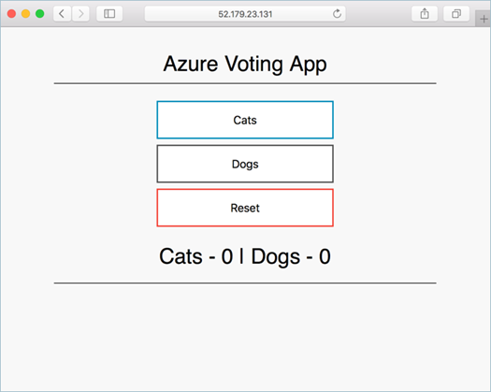
Demonstration – Deploy Azure Kubernetes Service (optional)
Create a Kubernetes service
Connect to the cluster
Test the applications
Notes:
QuickStart: Deploy an Azure Kubernetes Service (AKS) cluster using the Azure portal –
https://docs.microsoft.com/azure/aks/kubernetes-walkthrough-portal
https://learn.microsoft.com/en-us/azure/aks/tutorial-kubernetes-prepare-app?tabs=azure-cli

Slide 40
Summary and Resources – Configure Azure Kubernetes Service
Knowledge Check Questions
Microsoft Learn Modules (docs.microsoft.com/Learn)
Introduction to Azure Kubernetes Service
Implement Azure Kubernetes Service (AKS)
Notes:
Describe how Azure Kubernetes service pools, nodes, and pods work together.
Answer: Kubernetes is an open-source system for automating deployment, scaling, and management of containerized applications. Azure Kubernetes Service (AKS) makes it simple to deploy a managed Kubernetes cluster in Azure. Nodes are the individual VMs running the containerized applications. Pods are a single instance of an application. The application can contain multiple containers. Pools are groups of nodes with identical configurations. Both pools and nodes can be scaled.

